Slide 1
LMS Refresh
Kareem Boctor, Michael Lujan, and Marissa Sanchez

Slide 2
Goals of Refresh
Make LMS more aesthetically pleasing, while using DaVita Brand Guidelines
Easier Navigation for Users
Goal to Go-live Thursday, April 21st

Slide 3
Good to know
All Icons were either created by small tweaks to Iconography ppt that PEX sent me or by me in Canva
We couldn’t find a ton of stock photos for the carousel, so we used to free-to-use images via Canva
All colors and fonts are within DaVita Brand guidlines

Slide 4
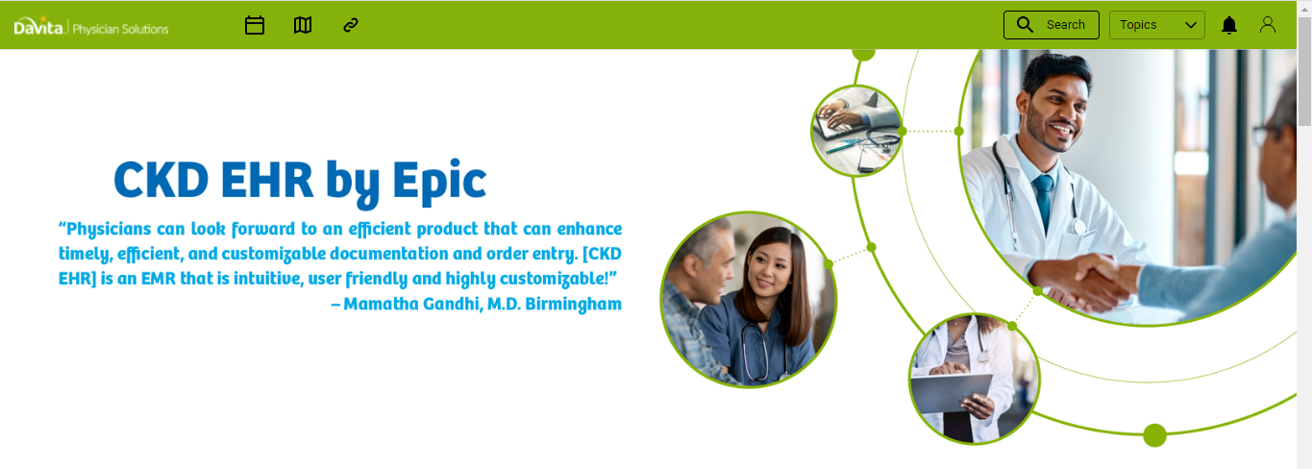
Carousel: Before

Slide 5
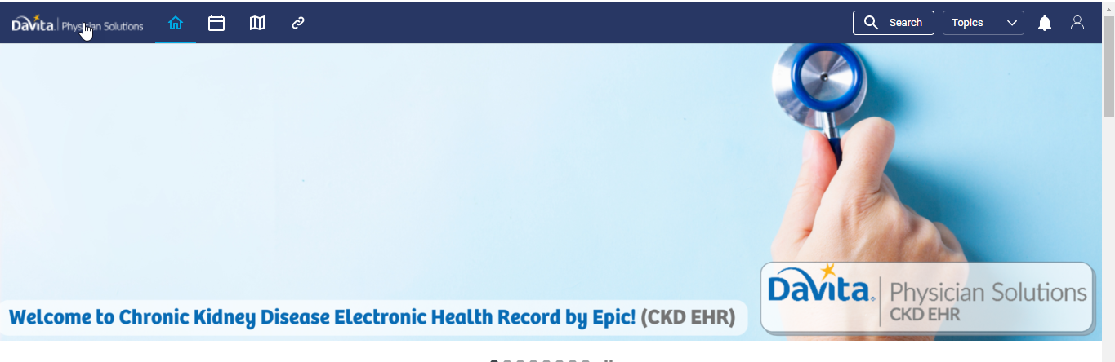
After: Carousel
We plan to add testimonials to these images once we have them.

Slide 6

After: Carousel

Slide 7
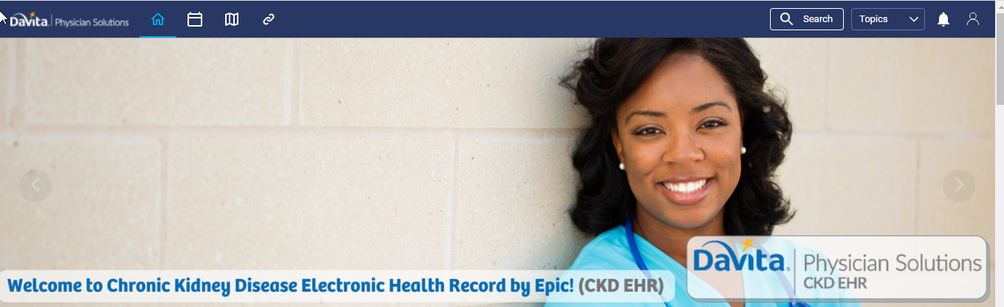
After: Carousel

Slide 8

After: Carousel

Slide 9

After: Carousel

Slide 10

After: Carousel

Slide 11

After: Carousel

Slide 12
After: Carousel

Slide 13
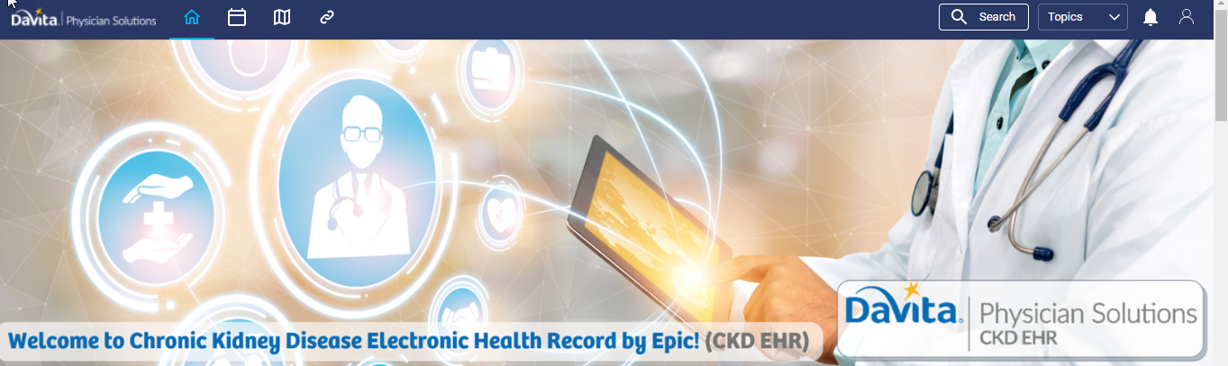
After: Carousel

Slide 14
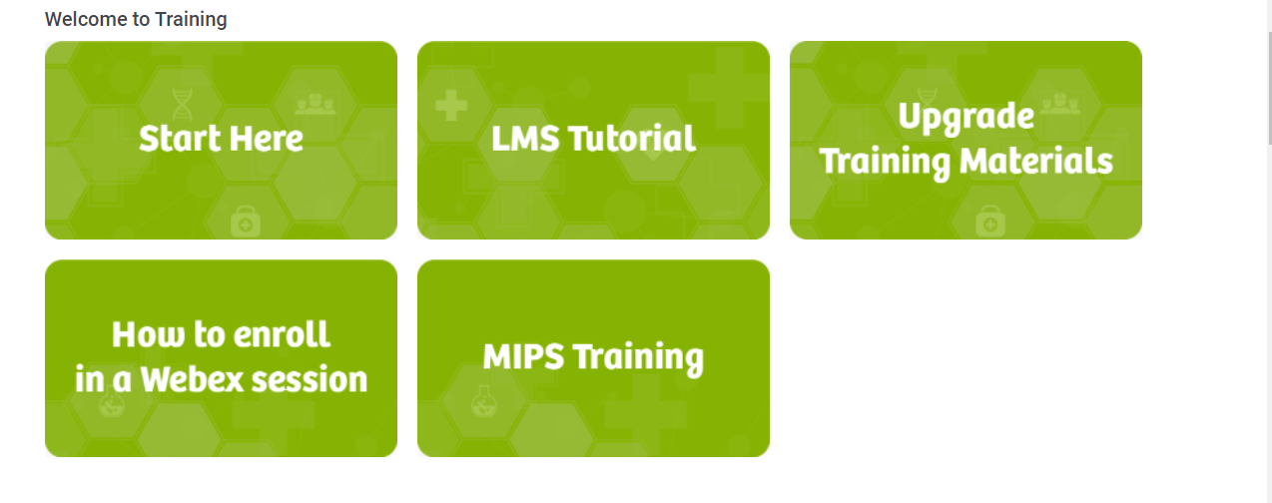
Before: Training Buttons

Slide 15
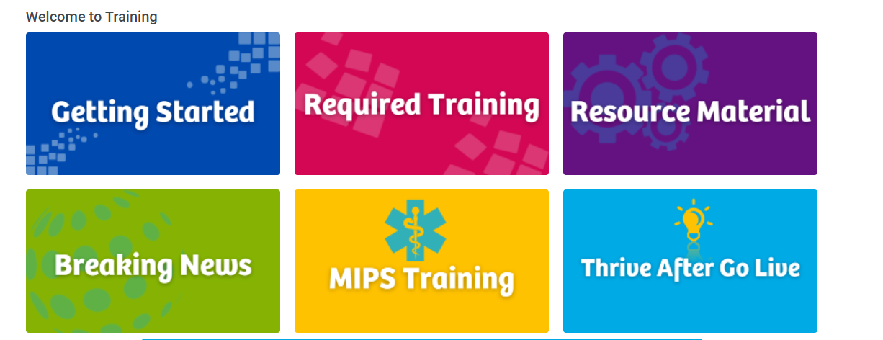
After: Training Buttons

Slide 16
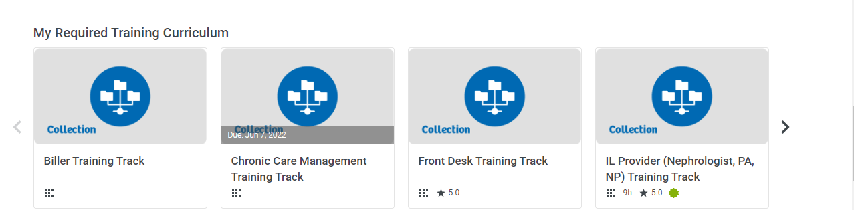
Icons for Tracks: Before

Slide 17
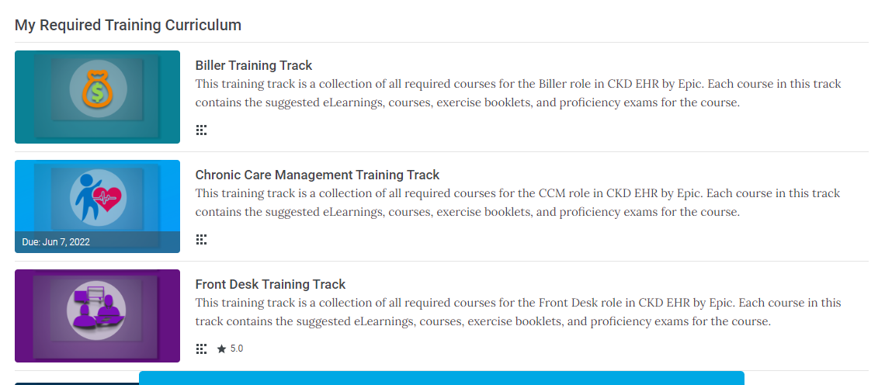
Icons for Tracks: After

Slide 18
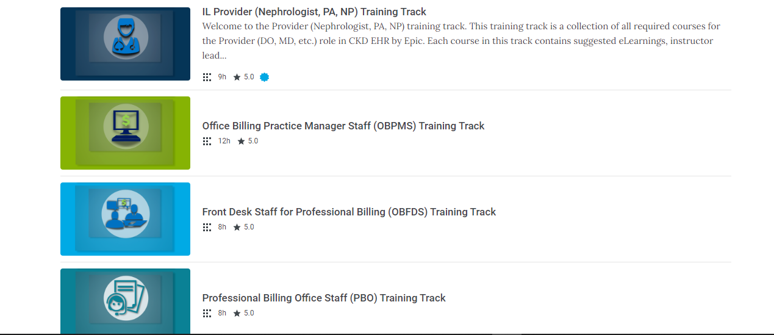
Icons for Tracks: After continued

Slide 19
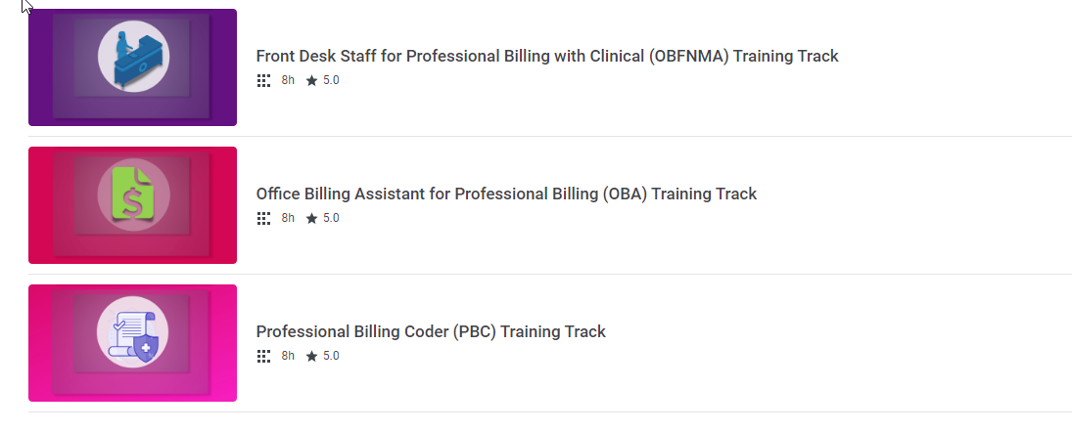
Icons for Tracks: After continued

Slide 20
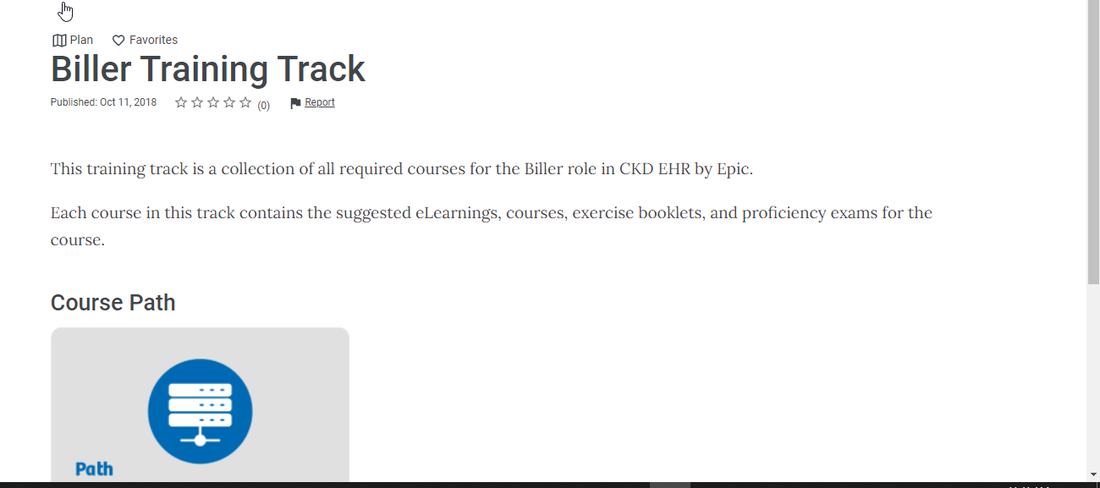
Before: No Hero Images for Tracks

Slide 21
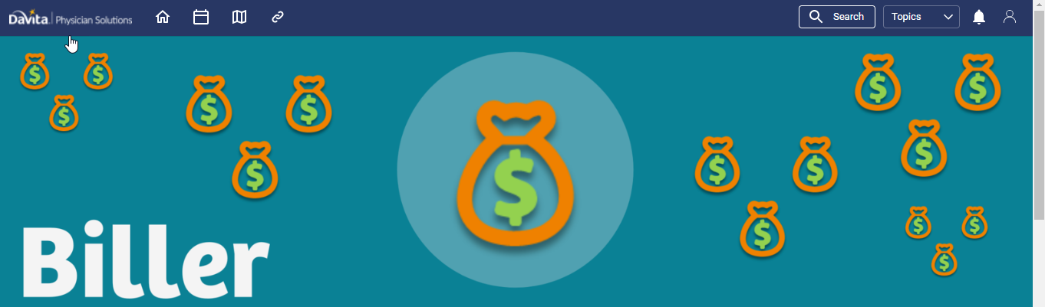
Hero Images for Tracks

Slide 22

Hero Images for Tracks

Slide 23
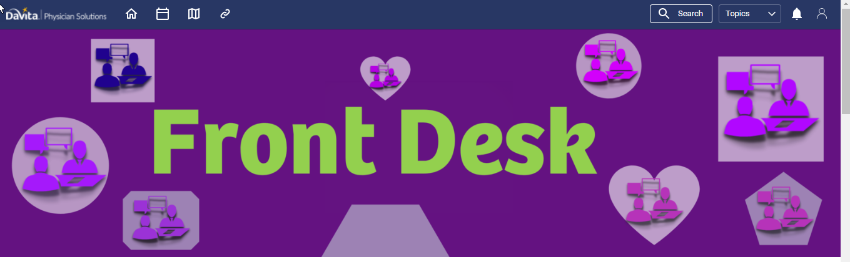
Hero Images for Tracks

Slide 24

Hero Images for Tracks

Slide 25
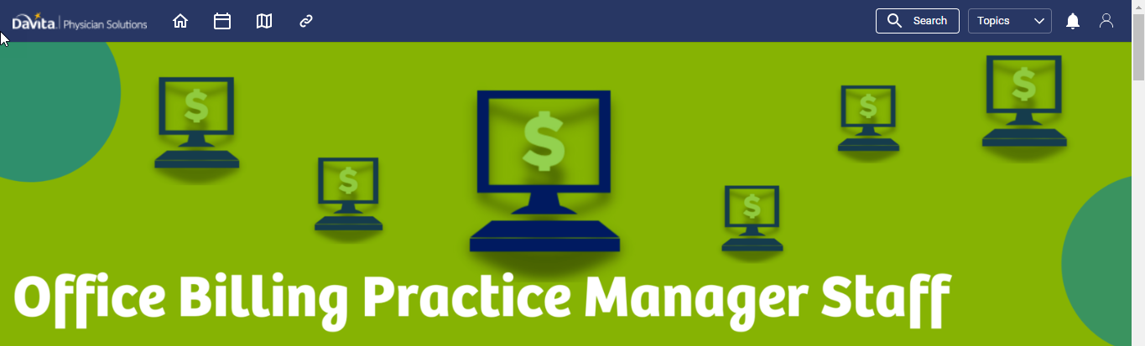
Hero Images for Tracks

Slide 26
Hero Images for Tracks

Slide 27
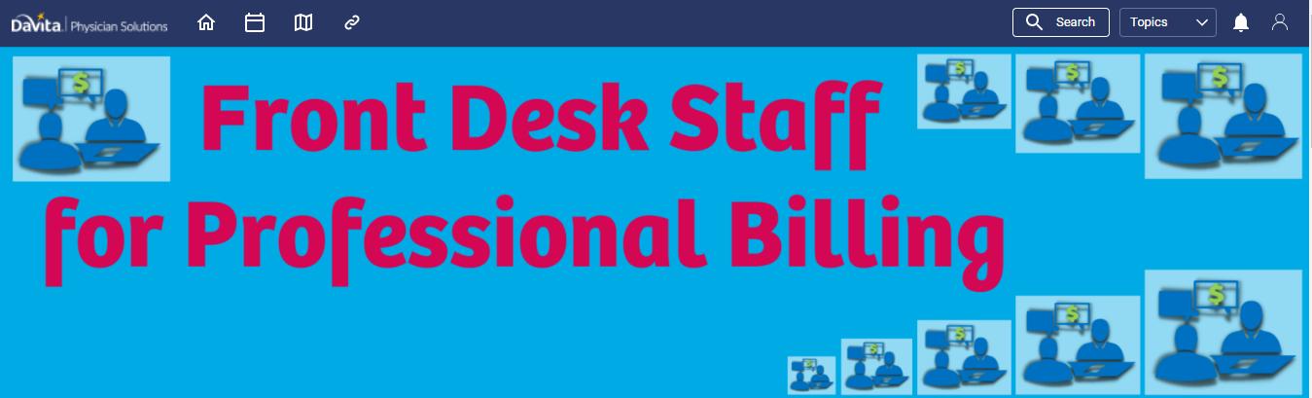
Hero Images for Tracks

Slide 28

Hero Images for Tracks

Slide 29
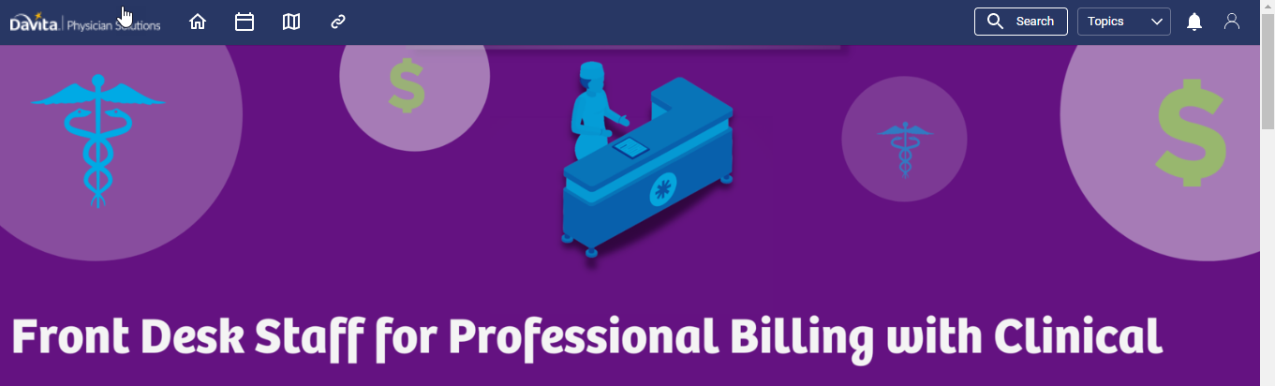
Hero Images for Tracks

Slide 30

Hero Images for Tracks

Slide 31
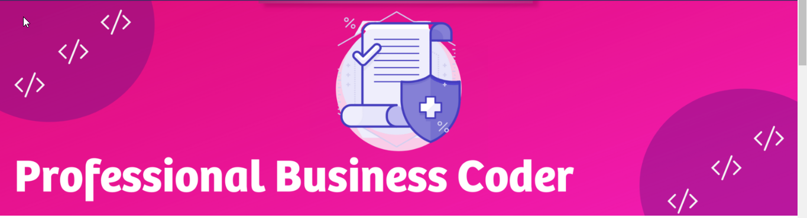
Hero Images for Tracks

Slide 32
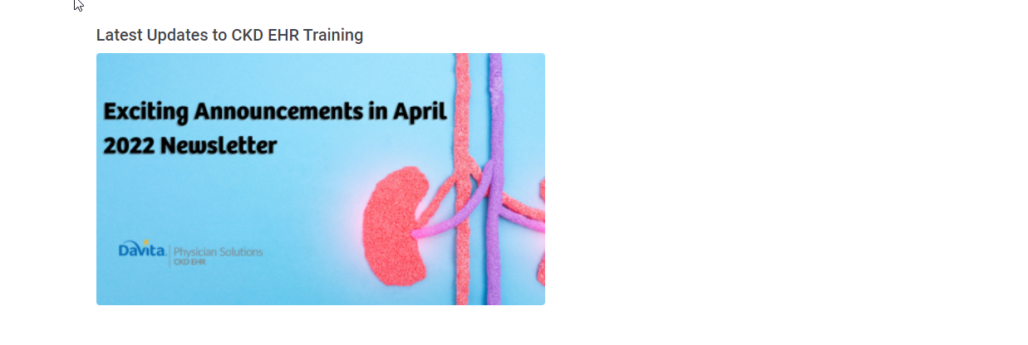
New Addition: Rotating Banners

Slide 33
Next Steps: Phase 2
Creating template for actual learning page with more pictures andless words
Different icons for different learning instruments being used.
Add more self-paced learning
Certificates for completing courses
Building more robust resource material section by adding tool tips into the LMS, so there's 2 locations to find material.

